Slide 1
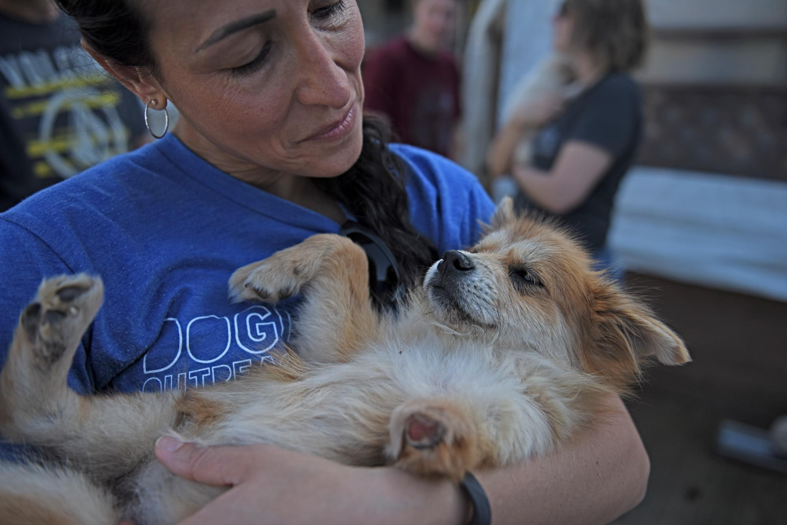
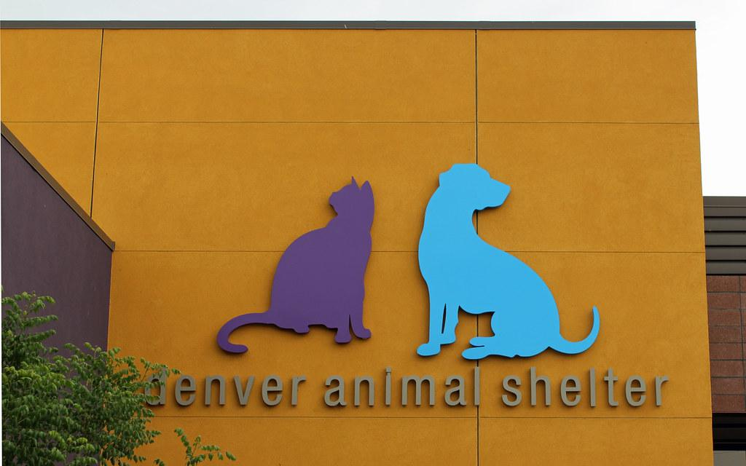
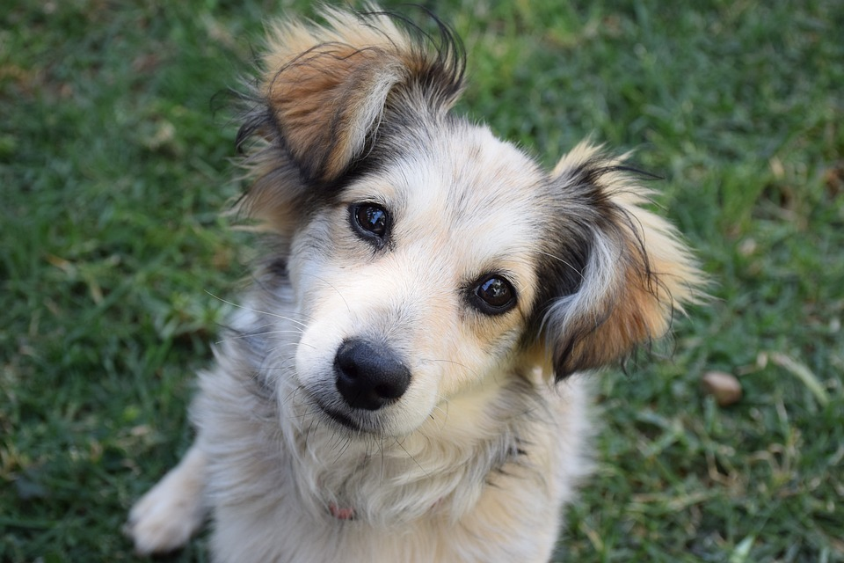
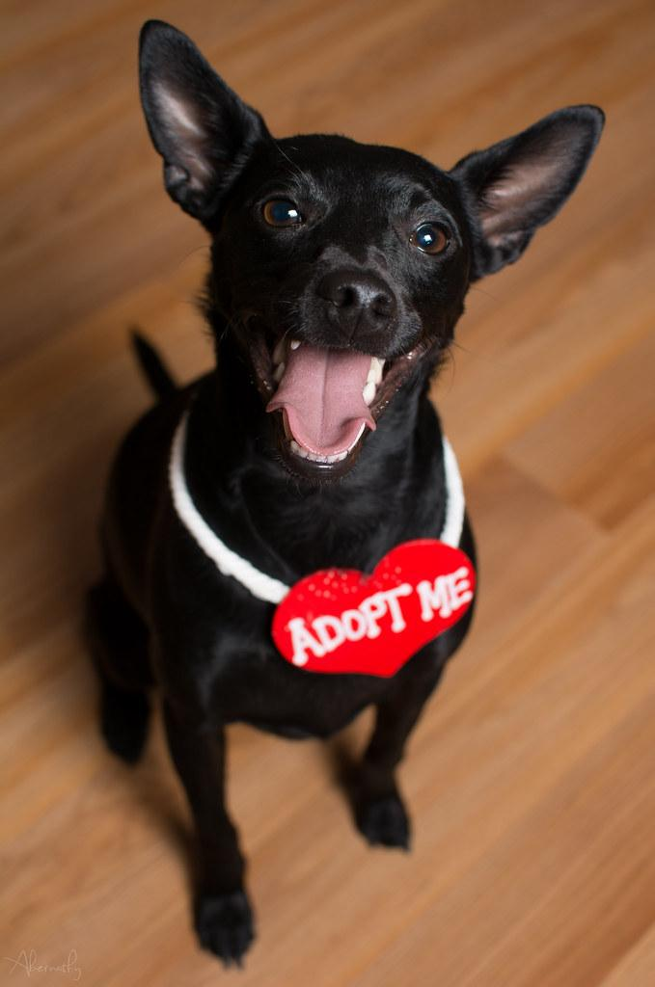
Furry Friends In Need
Project Coder: Kimberly Sams
FFIN is an animal rescue website with the added feature of having a built in location search bar to help people find available pets near them!

